Slide 1
EE227 – Digital Logic Design
Lecture 6 – 8

Slide 2
Outline
Boolean Algebra
Boolean Functions
Canonical Forms
Minterms and Maxterms
Standard forms
Sum of Products (SOP)
Product of Sums (POS)
Digital Logic Gates
Integrated Circuits
Quiz 1 Solution

Slide 3
Basic Definitions (1/2)
Boolean algebra, like any other deductive mathematical system, may be defined with a set of elements, a set of operators, and a number of unproved axioms
Set
A set of elements is any collection of objects, usually having a common property
If S is a set, and x and y are certain objects, then the notation x ∈ S means that x is a member of the set S and y ∉ S means that y is not an element of S
A set with a denumerable number of elements is specified by braces: A = {1, 2, 3, 4}

Slide 4
Basic Definitions (2/2)
Binary Operator
A binary operator defined on a set S of elements is a rule that assigns, to each pair of elements from S, a unique element from S
As an example, consider the relation a *b = c
We say that * is a binary operator if it specifies a rule for finding c from the pair (a, b) and also if a, b, c ∈ S
However, * is not a binary operator if a, b ∈ S, and if c ∉ S

Slide 5
The Postulates of a Mathematical System
Closure
A set is said to be closed if the result obtained after applying a binary operator belongs to the same set
Associative Law
(x * y) * z = x * (y * z) for all x, y, z, ∈ S
Commutative Law
(x * y) = (y * x) for all x, y, ∈ S
Identity Element
e * x = x * e = x for every x ∈ S
Inverse
x * y = e (y is inverse and e is identity element)
Distributive Law
x * (y . z) = (x * y) . (x * z)

Slide 6
Axiomatic Definition of Boolean Algebra (1/2)
In 1854, George Boole developed an algebraic system now called Boolean algebra
In 1938, Claude E. Shannon introduced a two‐valued Boolean algebra called switching algebra that represented the properties of bistable electrical switching circuits
We will discuss the two valued Boolean algebra only

Slide 7
Axiomatic Definition of Boolean Algebra (2/2)
Boolean algebra is an algebraic structure defined by a set of elements, B, together with two binary operators, + and . , provided that the following (Huntington) postulates are satisfied
The structure is closed with respect to + and .
The elements 0 and 1 are identity elements w.r.t + and . Respectively
The structure is commutative w.r.t + and .
The operator . is distributive over + and the operator + is distributive over .
For every x ∈ B there exists x’ ∈ B such that x + x’ = 1 and x.x’ = 0
There exist at least two elements x, y ∈ B such that x ≠ y

Slide 8
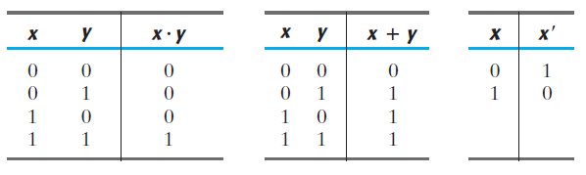
Two Valued Boolean Algebra
A two‐valued Boolean algebra is defined on a set of two elements, B = {0, 1}, with rules for the two binary operators + and . and complement as shown in the following operator tables
These rules are exactly the same as the AND, OR, and NOT operations, respectively

Slide 9
Practice Problem 1
Show that the Huntington postulates are valid for the set B = {0, 1} and the two binary operators + and .
Huntington postulates are:
The structure is closed with respect to + and .
The elements 0 and 1 are identity elements w.r.t + and . Respectively
The structure is commutative w.r.t + and .
The operator . is distributive over + and the operator + is distributive over .
For every x ∈ B there exists x’ ∈ B such that x + x’ = 1 and x.x’ = 0
There exist at least two elements x, y ∈ B such that x ≠ y

Slide 10
Basic Theorems and Properties of Boolean Algebra (1/2)
Duality
It states that every algebraic expression deducible from the postulates of Boolean algebra remains valid if the operators and identity elements are interchanged
If the dual of an algebraic expression is desired, we simply interchange OR and AND operators and replace 1’s by 0’s and 0’s by 1’s

Slide 11
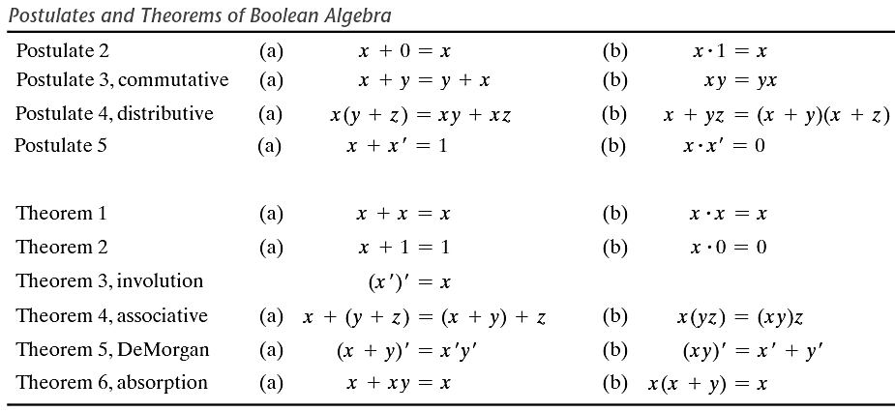
Basic Theorems and Properties of Boolean Algebra (2/2)

Slide 12
Practice Problem 2
Prove the followings
x + x = x
x . x = x
x + 1 = 1
x . 0 = 0
x + xy = x
x(x + y) = x
(x + y)’ = x’y’

Slide 13
Operator Precedence
The operator precedence for evaluating Boolean expressions
Parentheses
NOT
AND
OR

Slide 14
Boolean Functions (1/2)
A Boolean function described by an algebraic expression consists of binary variables, the constants 0 and 1, and the logic operation symbols
F₁ = x + y’z
A Boolean function can be represented in a truth table
The number of rows in the truth table is 2^{n}, where n is the number of variables in the function
A Boolean function can be transformed from an algebraic expression into a circuit diagram (also called schematic) composed of logic gates connected in a particular structure

Slide 15
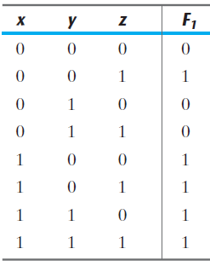
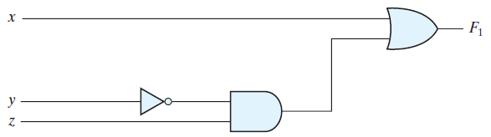
Boolean Functions (2/2)
F₁ = x + y’z

Slide 16
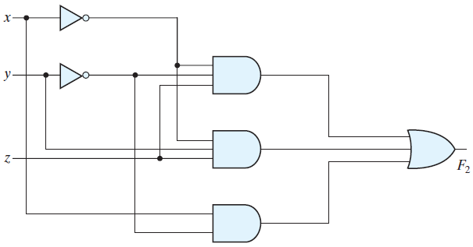
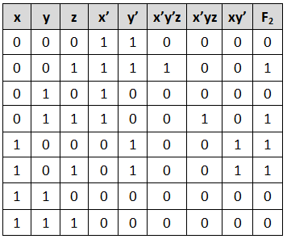
Practice Problem 3
Construct the truth table and circuit diagram for the following Boolean function
F₂ = x’y’z + x’yz + xy’

Slide 17
Algebraic Manipulation (1/2)
When a Boolean expression is implemented with logic gates, each term requires a gate and each variable within the term designates an input to the gate
We define a literal to be a single variable within a term
The function F₂ = x’y’z + x’yz + xy’ has 3 terms and 8 literals
By reducing the number of terms, the number of literals, or both in a Boolean expression, it is often possible to obtain a simpler circuit
The manipulation of Boolean algebra consists mostly of reducing an expression for the purpose of obtaining a simpler circuit

Slide 18
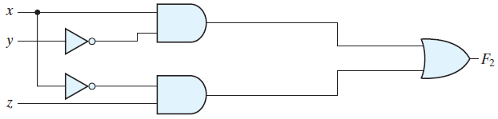
Algebraic Manipulation (2/2)
The simple manipulation consists of applying basic theorems and relations
The function F₂ = x’y’z + x’yz + xy’ can be simplified in the following way
F₂ = x’y’z + x’yz + xy’
F₂ = x’z(y’ + y) + xy’
F₂ = x’z(1) + xy’
F₂ = x’z + xy’
The same function is reduced to two terms. The truth table will be the same and the schematic is now simplified

Slide 19
Practice Problem 4
Simplify the following Boolean functions to a minimum number of literals. Also construct their truth tables and schematics
x(x’ + y)
x + x’y
(x + y)(x + y’)
xy + x’z + yz
(x + y)(x’ + z)(y + z)

Slide 20
Complement of a Function
The complement of a function F is F’ and can be obtained by an interchange of 1’s for 0’s and 0’s for 1’s in the value of the function
The complement of a function may be derived algebraically through DeMorgan’s theorems
DeMorgan’s theorems for any number of variables resemble the two‐variable case
(A + B + C + … + F)’ = A’B’C’… F’
(ABC … F)’ = A’ + B’ + C’ + … + F’
The complement of a function is obtained by interchanging AND and OR operators and complementing each literal

Slide 21
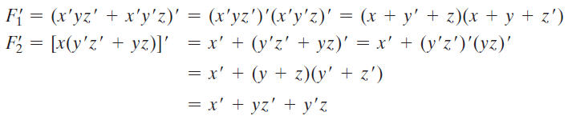
Practice Problem 5
Find the complements of the following functions by applying Demorgan’s laws
F₁ = x’yz’ + x’y’z
F₂ = x(y’z’ + yz)

Slide 22
Another Way to Compute the Complement of a Boolean Function
A simpler procedure for deriving the complement of a function is to take the dual of the function and complement each literal

Slide 23
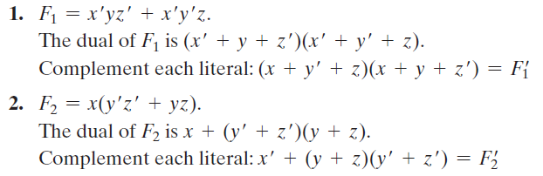
Practice Problem 6
Find the complements of the following functions by using duality
F₁ = x’yz’ + x’y’z
F₂ = x(y’z’ + yz)

Slide 24
Canonical Form
Boolean functions expressed as a sum of minterms or product of maxterms are said to be in canonical form
Minterms
The AND of N variables such that they equals to 1 is called minterm or standard product
There are 2^{N} possible minterms with N variables
Minterms are denoted by lower case m
Maxterms
The OR of N variables such that the result is equal to 0 is called maxterm or standard sum
There are 2^{N} possible minterms with N variables
Maxterms are denoted by upper case M

Slide 25
Calculating Minterms and Maxterms
Each minterm is obtained from an AND term of the n variables, with each variable being primed if the corresponding bit of the binary number is a 0 and unprimed if a 1
Each maxterm is obtained from an OR term of the n variables, with each variable being unprimed if the corresponding bit is a 0 and primed if a 1
The complement of a minterm is equal to its corresponding maxterm

Slide 26
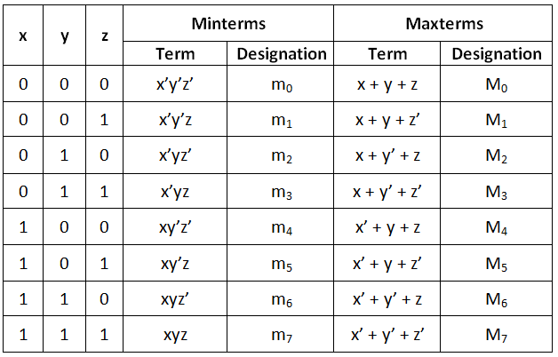
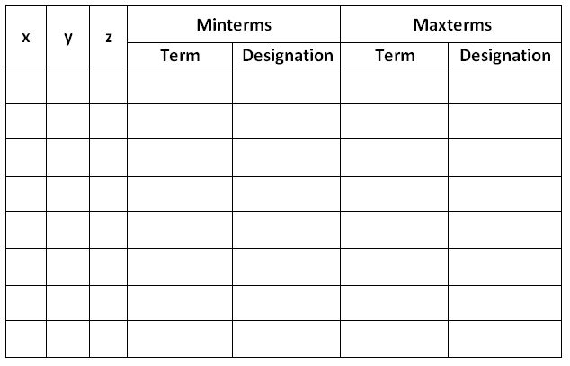
Minterms and Maxterms for 3 Variables

Slide 27
Representing a Boolean Function in Canonical Form
Boolean function can be represented in canonical form in two ways
As a sum of minterms
As a product of maxterms
To represent a Boolean function in canonical form all the terms of that function must contain all the variables

Slide 28
Boolean Function in Minterms
Derive the minterms mathematically
Introduce all the variables in each term by applying postulates/theorems of Boolean Algebra
Then form the minterms
Collect the minterms from truth table
Generate the truth table directly from the given function
Collect the minterms from the truth table

Slide 29
Practice Problem 7
Express the function F = A + B’C as a sum of minterms

Slide 30
Boolean Function in Maxterms
Derive the maxterms mathematically
First convert the function into OR terms
Introduce all the variables in each term by applying postulates/theorems of Boolean Algebra
Then form the maxterms
Collect the maxterms from truth table
Generate the truth table directly from the given function
Collect the maxterms from the truth table

Slide 31
Practice Problem 8
Express the Boolean function F = xy + x’z as a product of maxterms

Slide 32
Standard Forms
The canonical forms are seldom used
The two standard forms to represent Boolean functions are:
Sum of Products (SOP)
Each term is a sum of 1 or more literals
All the terms are combined with AND
F₁ = y’ + xy + x’yz’
Product of Sums (POS)
Each term is a product of 1 or more literals
All the terms are combined with OR
F₂ = x(y’ + z)(x’ + y + z’)
The standard forms always leads to a two level implementation

Slide 33
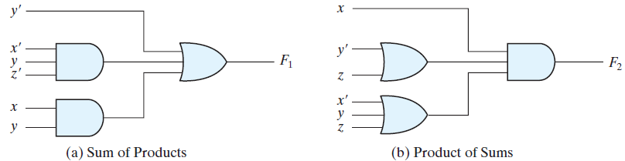
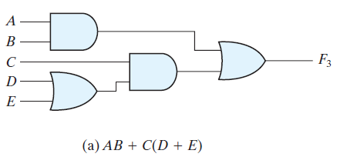
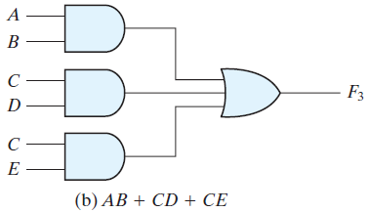
2 and 3 Level Implementation
Two Level Implementation
Three level implementation

Slide 34
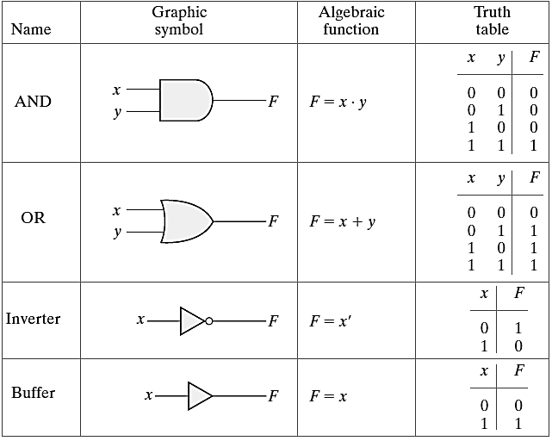
Digital Logic Gates (1/2)

Slide 35
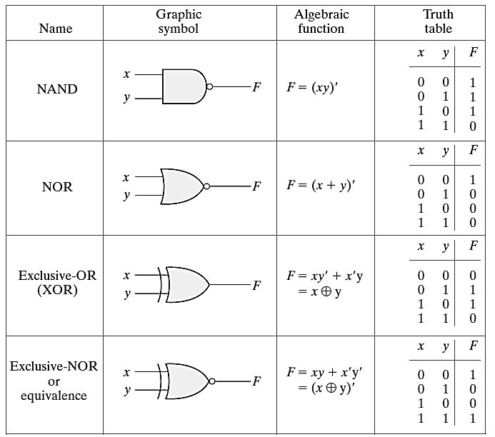
Digital Logic Gates (2/2)

Slide 36
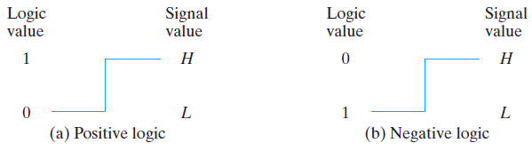
Positive and Negative Logic
The binary signal at the inputs and outputs of any gate has one of two values
One signal value represents logic 1 and the other logic 0
Since two signal values are assigned to two logic values, there exist two different assignments of signal level to logic value
Choosing the high‐level H to represent logic 1 defines a positive logic system
Choosing the low‐level L to represent logic 1 defines a negative logic system

Slide 37
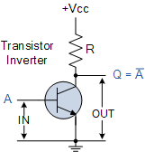
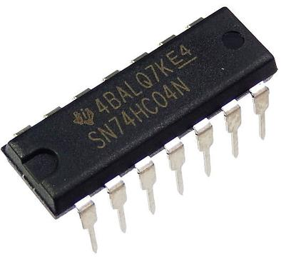
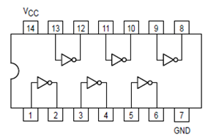
Integrated Circuits (1/4)
An integrated circuit (IC) is fabricated on a die of a silicon semiconductor crystal, called a chip, containing the electronic components for constructing digital gates
The various gates are interconnected inside the chip to form the required circuit
The number of pins may range from 3 on a small IC package to several thousand on a larger package
Each IC has a numeric designation printed on the surface of the package for identification

Slide 38
Integrated Circuits (2/4)
Level of Integration
Small Scale Integration (SSI)
The number of gates is usually fewer than 10
AND, OR, XOR etc ICs
Medium Scale Integration (MSI)
Have a complexity of approximately 10 to 1,000 gates in a single package
Decoders, adders, and multiplexers
Large Scale Integration (LSI)
These devices contain thousands of gates in a single package.
They include digital systems such as processors, memory chips, and programmable logic devices
Very Large Scale Integration (VLSI)
Contain millions of gates within a single package
Examples are large memory arrays and complex microcomputer chips

Slide 39
Integrated Circuits (3/4)
Digital Logic Families
The circuit technology of an IC is referred to as a digital logic family
TTL (transistor-transistor logic)
50 years old and standard method
ECL (emitter coupled logic)
For high speed operations
MOS (metal oxide semiconductor)
Suitable for circuits that need high component density
CMOS (complementary metal‐oxide semiconductor)
CMOS is preferable in systems requiring low power consumption

Slide 40
Integrated Circuits (4/4)
Fan‐out
It specifies the number of standard loads that the output of a typical gate can drive without impairing its normal operation
Fan‐in
It is the number of inputs available in a gate
Power dissipation
It is the power consumed by the gate that must be available from the power supply
Propagation delay
It is the average transition delay time for a signal to propagate from input to output
Noise margin
It is the maximum external noise voltage added to an input signal that does not cause an undesirable change in the circuit output

Slide 41
Quiz 1
Solution

Slide 42
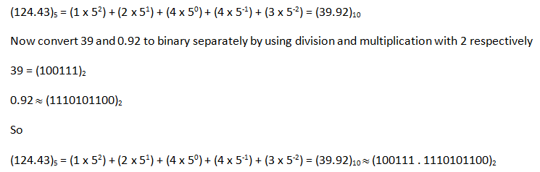
Quiz 1 (Paper A)
Question Number 1 [8 Marks]
Convert (124.43)₅ to its binary equivalent

Slide 43
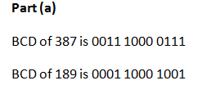
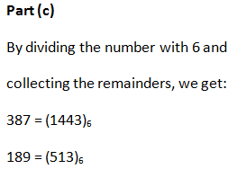
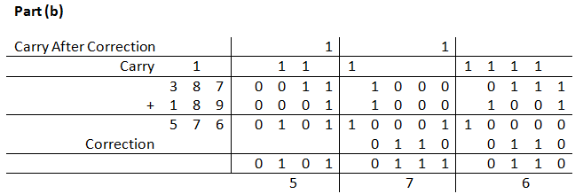
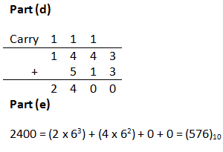
Quiz 1 (Paper A)
Question Number 2 [1 + 5 + 1 + 3 + 2 = 12 Marks]
Two decimal numbers are given as A = 387 and B = 189.
Write their equivalent BCD codes
Add both these numbers by using BCD codes
Convert A and B in base 6.
Add them in base 6
And prove that the answer is same as in decimal

Slide 44
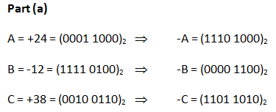
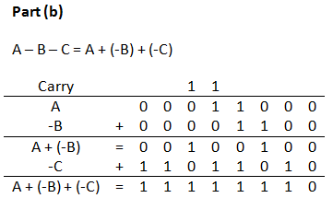
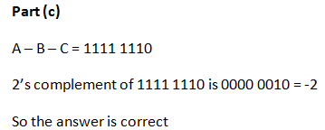
Quiz 1 (Paper B)
Question Number 1 [2 + 8 + 2 = 12 Marks]
Let A = 24, B = –12 and C = 38
Represent them in 2’s complement form in binary by using 8 bits
Calculate A – B – C by using 2’s complement method
And verify that your answer is correct.

Slide 45
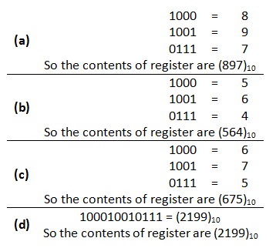
Quiz 1 (Paper B)
Question Number 2 [4 x 2 = 8 Marks]
The state of a 12‐bit register is 100010010111. What is its content if it represents
Three decimal digits in BCD
Three decimal digits in the excess‐3 code
Three decimal digits in the 6,3,1,1 code
A binary number

